Slide 1
Cloudburst Prediction System
PIP4004 University Project-II
Review-1
Batch Number: CSE-G121
Under the Supervision of,
Ms. Rakeeba Taseen
Professor / Associate Professor / Assistant Professor
School of Computer Science & Engineering
Presidency University
ROLL NUMBER | STUDENT NAME
20211CSE0413 | SUSHMA M MADDIN
20211CSE0421 | SINCHANA A U
20211CSE0437 | K H SRUJAN GOWDA

Slide 2
Introduction
Cloudbursts are extreme weather phenomena characterized by sudden, heavy rainfall over a localized area in a short span of time. These events can trigger flash floods, landslides, and significant damage to infrastructure, posing serious risks to human lives and the environment. Traditional meteorological forecasting methods often struggle to predict cloudbursts due to their highly localized and erratic nature. The unpredictability of these events makes early warning systems crucial for disaster preparedness and mitigation efforts. This project focuses on developing a Machine Learning (ML)-based Cloudburst Prediction System to enhance forecasting accuracy. By leveraging historical meteorological data and real-time weather inputs, the system will analyse key atmospheric parameters such as temperature, humidity, air pressure, wind speed, and rainfall intensity to estimate cloudburst probabilities. Unlike conventional forecasting models, ML techniques can recognize complex patterns and correlations in weather data, improving the precision of predictions. A web-based application will be designed to allow users to input real-time weather data, enabling automated cloudburst probability assessments. Additionally, an alert mechanism will be integrated into the system to notify users via SMS, email, or push notifications when the risk of a cloudburst is high. This feature will be particularly useful for meteorological departments, disaster management authorities, and local communities in high-risk areas. By providing timely warnings and actionable insights, this project aims to reduce the devastating impact of cloudbursts, improve disaster preparedness, and aid in decision-making for emergency response teams. The proposed system aligns with the broader goal of using advanced technologies to enhance climate resilience and disaster management strategies.

Slide 3
Literature Review
Several studies have explored weather prediction using statistical and machine learning (ML) techniques to improve forecasting accuracy, particularly for extreme events like cloudbursts. Traditional Numerical Weather Prediction (NWP) models rely on mathematical equations to simulate atmospheric conditions but struggle with localized and short-term events due to their dependence on large-scale data and computational intensity. Recent research has demonstrated that ML algorithms, such as Random Forest (RF), Support Vector Machines (SVM), Artificial Neural Networks (ANNs), and Long Short-Term Memory (LSTM) networks, can effectively analyze historical and real-time meteorological data to identify patterns and correlations that traditional models often miss. Hybrid approaches, such as integrating LSTM with Convolutional Neural Networks (CNNs), have shown promising results in short-term rainfall forecasting. However, the effectiveness of ML models depends on real-time data availability, as cloudbursts occur suddenly and unpredictably. Studies suggest that integrating IoT-based weather sensors, satellite data, and crowd sourced weather information can enhance prediction accuracy. Additionally, research highlights the need for automated early warning systems, such as SMS, email, and push notifications, to ensure timely alerts for disaster preparedness. This project builds on these advancements by developing an ML-based cloudburst prediction system that integrates real-time data processing, predictive modeling, and automated alert mechanisms to enhance forecasting precision and early warning capabilities.

Slide 4
Proposed Method
The proposed system will be a web-based application integrated with a Machine Learning (ML) model to predict cloudbursts based on meteorological data. The system will include the following features:
ML-Based Prediction Model: A trained model will analyze historical and real-time weather data to predict the probability of a cloudburst occurring. The model will continuously update its predictions as new data is provided.
User Input Form for Manual Data Entry: The website will have a simple form where users can manually enter weather parameters if real-time data is unavailable or if they want to test different scenarios.
Automated Alert System: The system will send SMS, email, or push notifications to warn users when a high probability of a cloudburst is detected, allowing for early action and disaster preparedness.
User-Friendly Web Interface: A simple and interactive web dashboard will allow users to input data, view predictions, and receive alerts easily. The interface will be designed to be accessible to disaster management teams, meteorologists, and local authorities.

Slide 5
Objectives
The key objectives of this project are:
To develop an ML-based system capable of predicting cloudbursts using meteorological data.
To collect and preprocess historical and real-time weather data for training the model.
To implement a web-based interface for user-friendly weather data input and predictions.
To integrate an alert mechanism (SMS, email, push notifications) to notify users of potential cloudbursts.
To enhance early warning systems for better disaster preparedness and mitigation.

Slide 6
Methodology
Phase 1: Data Collection & Preprocessing
Gather historical meteorological data from reliable sources (e.g., IMD, NOAA, NASA).
Fetch real-time weather data via APIs or manual input.
Clean and preprocess the data (handling missing values, normalization, feature selection).
Phase 2: Machine Learning Model Development
Train different ML models (e.g., Decision Trees, Random Forest, SVM, Neural Networks).
Evaluate models using performance metrics like accuracy, precision, recall, and F1-score.
Optimize and fine-tune the best-performing model for cloudburst prediction.
Phase 3: Web Application & Alert System
Develop a web application for user input and predictions.
Integrate an alert system (via SMS, email, or push notifications) to warn users.
Deploy the system for real-time usage and continuous improvement.

Slide 7
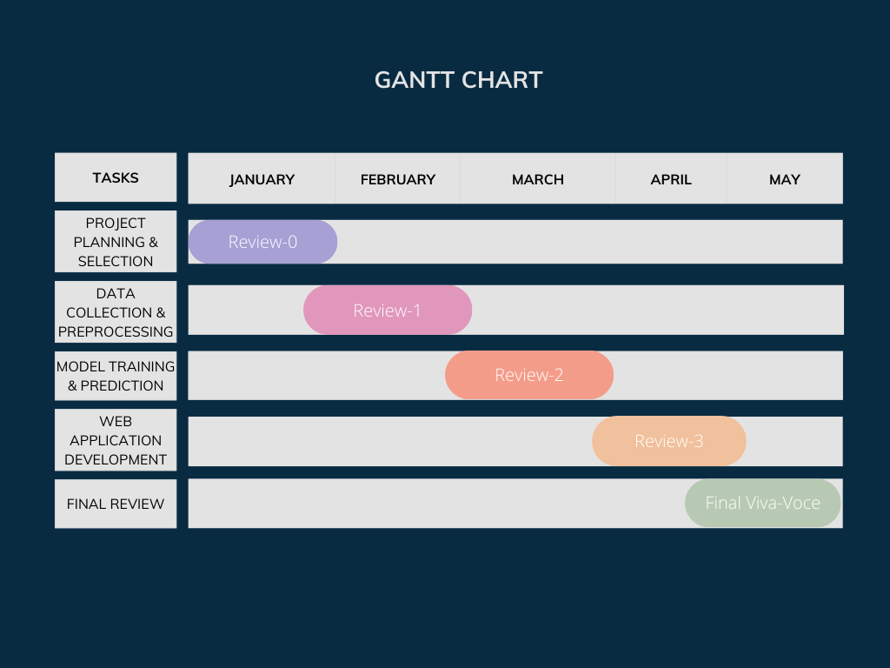
Timeline of Project

Slide 8
Expected Outcomes
Accurate Cloudburst Predictions: A trained Machine Learning (ML) model capable of predicting cloudbursts based on real-time and historical meteorological data, improving early warning capabilities.
User-Friendly Web Application: A simple and intuitive web-based interface where users can enter weather parameters manually or rely on real-time API data for predictions.
Improved Disaster Preparedness: By providing real-time alerts and warnings, the system will help authorities, meteorologists, and local communities take preventive measures, reducing the impact of cloudbursts.

Slide 9
Conclusion
Cloudbursts are unpredictable and highly destructive weather events that often result in severe flooding and loss of life. Traditional weather forecasting models struggle to provide accurate and timely warnings due to the localized nature and sudden onset of these events. This project aims to bridge the gap in cloudburst prediction by leveraging Machine Learning (ML) techniques and real-time meteorological data analysis. By utilizing historical weather data and live inputs, the trained ML model will enhance forecasting accuracy and provide data-driven insights for better preparedness. A key innovation of this project is the integration of a web-based application that allows users to manually input weather parameters or access real-time data for automated cloudburst predictions. Additionally, the system will feature an automated alert mechanism, notifying relevant stakeholders via SMS, email, or push notifications in case of high-risk weather conditions. This proactive approach will enable disaster management authorities, meteorological departments, and local communities to take timely preventive measures, minimizing the potential damage caused by cloudbursts. The successful implementation of this system has the potential to significantly improve early warning capabilities, reduce casualties, and mitigate economic losses caused by extreme weather conditions. Furthermore, this project contributes to the broader field of AI-driven climate prediction and can be extended to other extreme weather forecasting applications, such as storm prediction, flash flood warnings, and climate anomaly detection. By combining advanced ML models, real-time data processing, and an intuitive user interface, this system represents a step forward in modernizing disaster preparedness and response strategies, ultimately helping to save lives and protect valuable resources.

Slide 10
References
[1] D. Knos, K. Karagiorgos, J. Haas, B. Blumenthal, L. Nyberg, and S. Halldin, “Cloudburst-disaster modelling: A new open-source catastrophe model,” Centre for Societal Risk Research, Karlstad University, Sweden, 2022.
[2] D. Karunanidy, P. S. Rakshith, G. Sireesha, N. M., M. Kumar, and M. Sreedevi, “Cloudburst Prediction in India Using Machine Learning,” IEEE, 2023.
[3] A. S. Raghuvanshi, R. M. Trigo, and A. Agarwal, “Climatology of extreme precipitation spells induced by cloudburst-like events during the Indian Summer Monsoon,” Department of Hydrology, IIT Roorkee, India, 2021.
[4] A. Tejaswini Reddy, B. Venkatesh, and S. Reddy, “Cloudburst Prediction in India Using Machine Learning,” Anurag University, Telangana, India, 2023.
[5] S. Telsang, P. Sawale, S. Pujari, V. Pujari, A. Pungale, R. Dubewar, and R. Shendre, “Cloudburst Prediction System Using Machine Learning,” Vishwakarma Institute of Technology, Pune, India, 2022.

Slide 11
References
[6] A. Tiwari and S. K. Verma, “Cloudburst Predetermination System,” Department of CSE, GBPEC, Pauri, India, 2022.
[7] G. G. A., A. Anjum, G. N. Hegde, G. S. V., and G. N. Hegde, “The Cloudburst Prediction System,” City Engineering College, Bangalore, India, 2022.
[8] S. M., R. P., and B. A., “Sequence Model based Cloudburst Prediction for the Indian State of Uttarakhand,” VIT Chennai, India, 2023.
[9] S. Das, R. Ashrit, and M. W. Moncrieff, “Simulation of a Himalayan cloudburst event,” National Center for Medium Range Weather Forecasting and National Center for Atmospheric Research, India and USA, 2021.
[10] B. R. Reddy, S. Anchuri, K. Santhi, P. Perugu, S. Depuru, and M. S. Kumar, “Enhancing Cloudburst Prediction System Using Bi-LSTM in Realtime: Machine Learning,” Canadian Journal of Advanced Networking and Applications (CANA), vol. 32, 2023.

Slide 12
Thank You

